Slide 1


AI-INSIGHTS
AI-Powered Review Summarization System
Presented by Naidhruvan, Raghu, Arman and Anisha

Slide 2

The Dilemma
Overwhelmed by Choices
Customers are bombarded with hundreds of reviews, leading to confusion and decision fatigue, making it difficult to discern product quality and make informed purchases.

Slide 3

The Challenge
NLP Review Summarization
Extracting meaningful insights from extensive reviews is complex. The AI model’s task is to summarize reviews, focusing on pros, cons, and sentiment analysis.

Slide 4
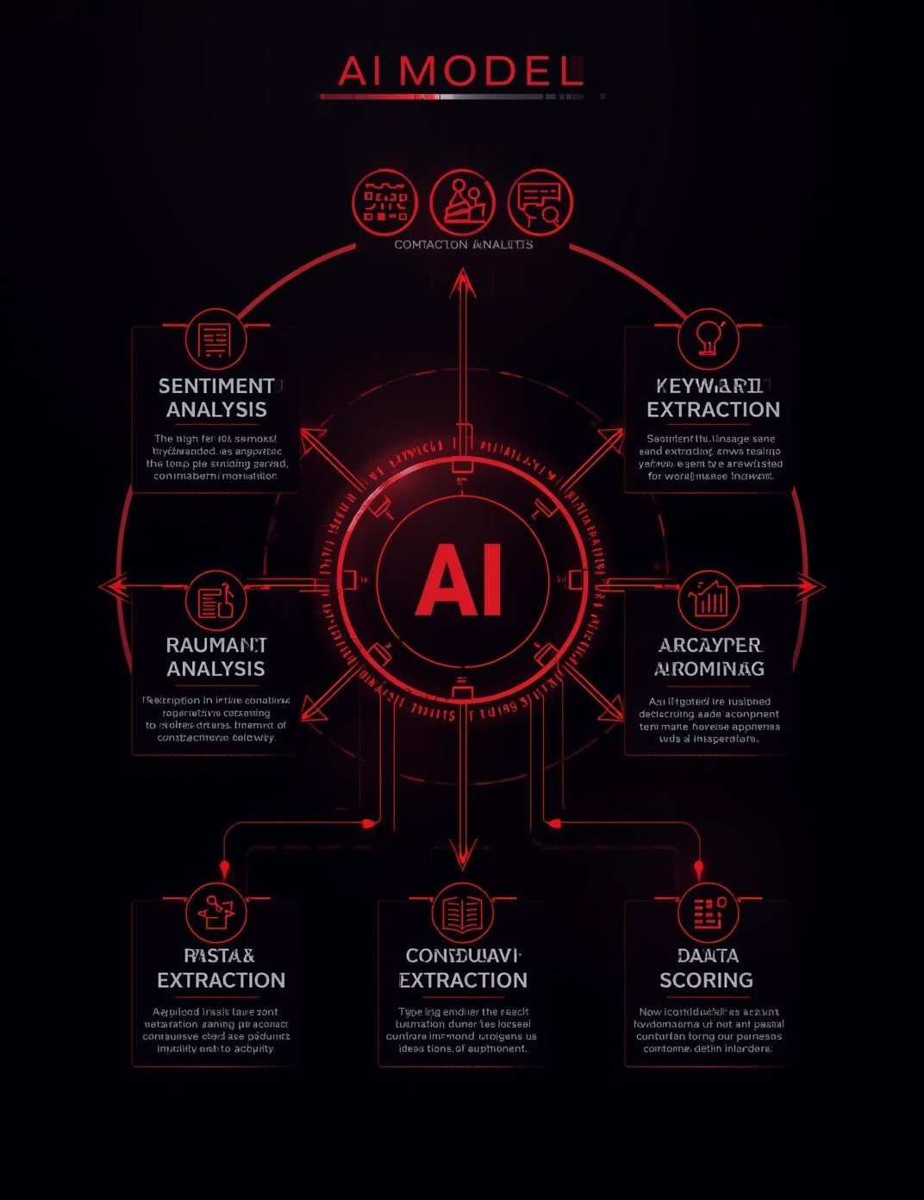
Proposed Solution
AI/NLP Model Overview
Our AI-powered solution leverages sentiment analysis and keyword extraction to summarize reviews, providing concise insights and confidence scoring for smarter decision-making.

Slide 5
Data Flow Pipeline
Sentiment Analysis
Aggregation & Scoring
Data Cleaning
Preprocessing
Remove duplicates and irrelevant information from raw product reviews.
Format and structure text data for effective analysis and processing.
Analyze reviews to extract sentiment using NLP techniques and algorithms.
Combine results to generate overall scores and key insights for users.

Slide 6
NLP Model Workflow
Tokenization
Lemmatization
POS Tagging
VADER
Splitting text into individual words or tokens for processing.
Converting words to their base or root form for analysis.
Identifying parts of speech to understand sentence structure.
Analyzing sentiment of text data using a predefined lexicon.

Slide 7


Algorithm Logic
Scoring Methodology
This section details the confidence formula and how sentiment aggregation is calculated to ensure accurate and reliable results from our AI summarization model.

Slide 8
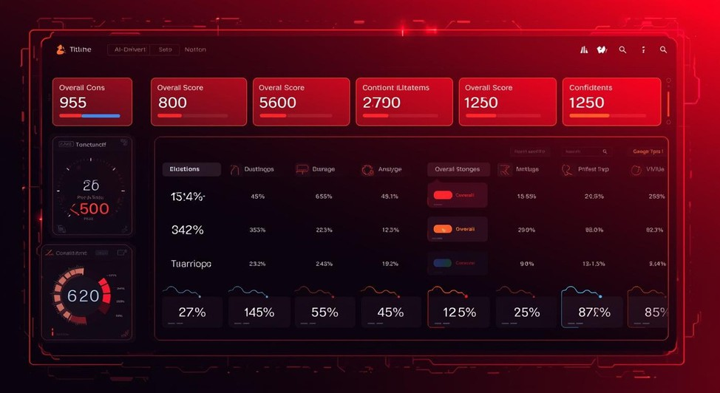
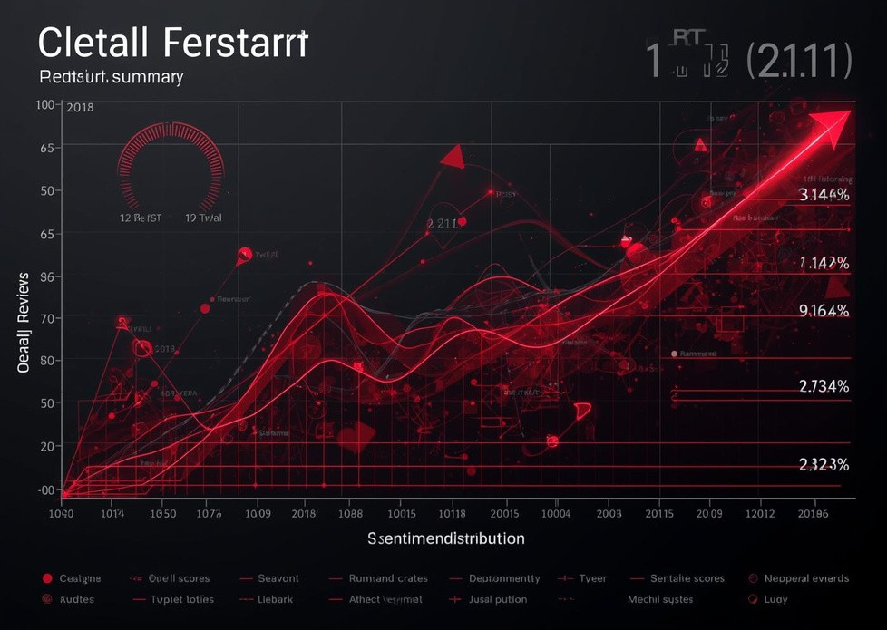
Output Summary Example
Key Insights from Reviews
This section provides a visual representation of the pros, cons, overall score, and confidence level derived from the summarized reviews, showcasing actionable insights for buyers.

Slide 9
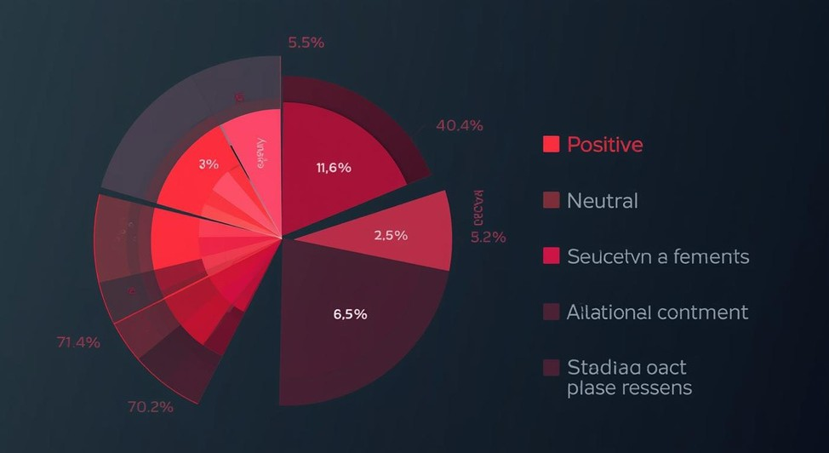
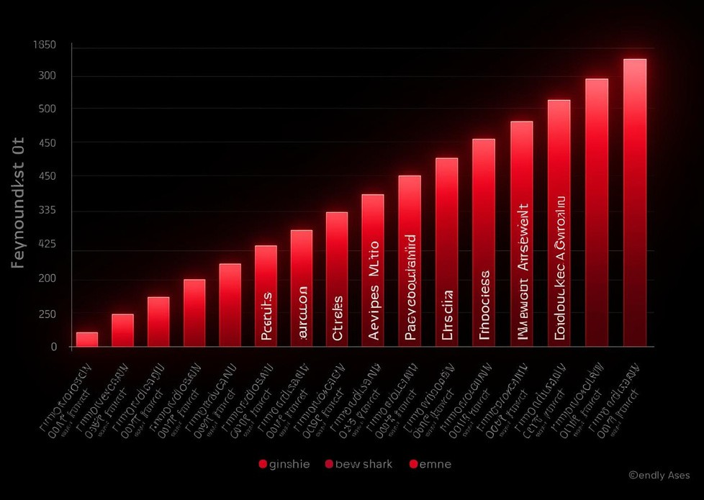
Sentiment & Keyword Insights
Analyzing Review Dynamics
Understanding sentiment ratios and identifying trending keywords help businesses gain valuable insights into customer preferences and improve their product offerings effectively.

Slide 10
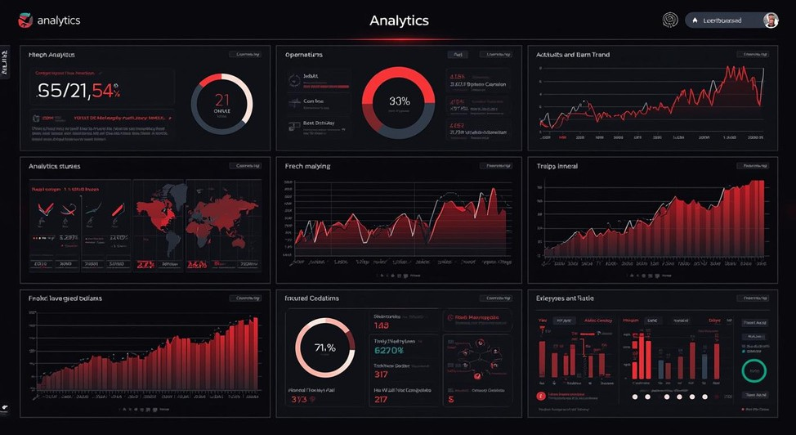

Business Impact
Smarter Buying Solutions
Our AI-powered system provides significant time savings and delivers data-driven insights, enabling consumers to make informed decisions and enhancing overall buying experiences.

Slide 11
Essential Tech Stack
01
02
03
04
Python enables rapid development and flexibility for our model.
NLTK provides robust tools for natural language processing tasks.
Pandas allows efficient data manipulation and analysis during processing.
Re helps extract and clean specific patterns from text data.
05
06
07
08
Basic Frontend Languages:
HTML
CSS
JavaScript
Libraries:
React.js
GSAP
Framework:
Next.js
Backend:
Fast API
Ngrok
Real-time Amazon Data(RapidAPI)

Slide 12

Future Enhancements
Expanding Our Capabilities
Our vision includes LLM-based summarization, multi- language support, and a live API, ensuring our system remains adaptable , meets diverse user needs across markets, categorical changes for confidence formula’s, checking for sarcastic tone and image analysis

Slide 13
Credits
Ele;;;
If (Frontend) {
cout <<( “Raghu Pratap Singh” + “Arman Sahu”) ;}
else if(Backend){
cout <<“Raghu Pratap Singh”}
else if(NLP){
cout <<“Naidhruvan Konher” + “Arman Sahu”;}
else if(PPT){
Cout <<“Naidhruvan Konher” + “Anisha”;}
else{
cout <<“All”;}

